Slide 1


Slide 2
You’ll Be Certified by the Networking Leader
Cisco pioneered routing and switching technologies—and continues to lead the way, with the greatest market share and largest installed base across many industries.

Slide 3

Certification Is the Foundation That Networking Careers Are Built Upon
Ever since the CCNA program began, Cisco certifications have been coveted by network engineers and employers all over the world.

Slide 4

Certification Gives You More Career Options
With a CCNA Routing and Switching certification, your IT career path will have seemingly limitless possibilities. IDC has found that seven out of 10 organizations look for certifications when they're hiring or promoting. With Cisco, you can continue upward along the Routing and Switching track, progressing through the Professional and Expert levels.

Slide 5

Certification Prepares You for Network Evolution in the Digital Era
As business becomes increasingly transformed by digitization, the network infrastructure is experiencing radical change. Much of the manual process of operating traditional networks has given way to a software-driven network architecture that depends on virtualization, automation, analytics, cloud service management, and the ability of the architecture to be open and extensible.

Slide 6
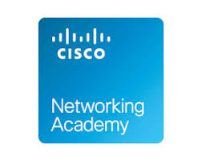
Certification Keeps You Current on All the Latest Technology Changes
Cisco continually surveys the changing IT landscape for myriad technological developments that have an impact on our certifications and your job role as a networking pro. CCNA Routing and Switching is no exception. Cisco's latest revision to the curriculum incorporates an understanding of quality of service (QoS) elements and their applicability, the interactions and network functions of firewalls, and wireless controllers and access points, along with additional focus on IPv6 and basic network security.

Slide 7

Certification Helps You Stand Out with Your Employer
By pursuing your Cisco CCNA Routing and Switching certification, you're telling your employer that you want to excel in your career. Managers notice that kind of initiative.

Slide 8
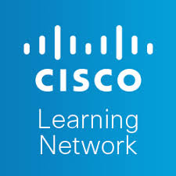
Certification Helps You Learn from Your Peers
As more professionals are earning Cisco certifications, a vibrant learning and career development community called the Cisco Learning Network has emerged.

Slide 9

Certification Gives You a Full Range of Training Options
There's more than one way to learn. And, through our Cisco Authorized Learning Partners, we offer a complete suite of flexible training options to make it easier for you to earn your CCNA Routing and Switching certification. You can enroll in instructor-led training, a virtual classroom experience, or hands-on labs for the ICND1 and ICND2 components of a CCNA Routing and Switching certification.

Slide 10
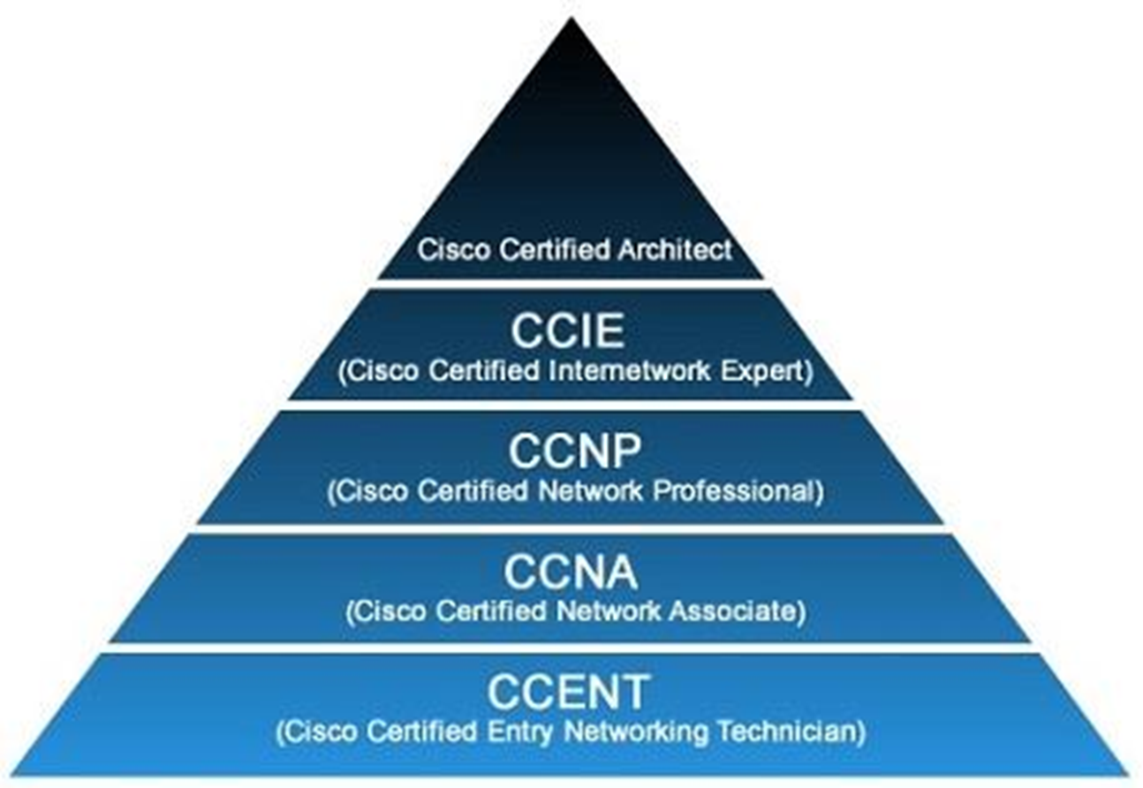
Certification Pyramid

Slide 11

Certification Helps Increase Your Paycheck
Salaries for IT networking jobs continue to surge, often fueled by a worldwide talent shortage. And your Cisco certification increases your earning potential. In its 2018 Technology Salary Guide, Robert Half Technology lists CCNA Routing and Switching certification as one of the most sought-after certifications in North America, and adds that employers may increase salaries 5 to 10 percent for evidence of such in-demand abilities.

Slide 12
And Don’t Forget: There Is Value in Recertification
When it comes time to recertify your status as an IT superstar, you can be confident that the effort will remain a powerful, industry-recognized way to validate your knowledge. That’s because Cisco continually monitors its certifications to ensure that they are keeping pace with IT requirements. When you adopt the attitude of a lifelong learner and recertify, you make sure you are up to date in the training that you have worked hard for.

