Slide 1
Money Managing Tips for International Students
Office of Student Financial Aid

Slide 2
Money Savings Tips for International Students
Agenda
Budget
Banking
Specific Ways to Save
Other Ideas
“Live like a __________ now, you’ll live like a student after you graduate.”

Slide 3
Budget / Spending Plan
Get one and stick to it!
http://www.accessgroup.org/calculators
Use cash instead of debit card, less likely to spend.
Try keeping a spending journal for one month.
Envelope System
Put monthly amount in an envelope – when gone – no more – or move between envelopes.

Slide 4
Budget
If you’re here for a few years, utility companies offer payment plans that level off payments to same each month
Two $3.50 Starbucks Coffees = $364 a year
Useful Websites:
http://www.regent.edu/admin/finaid/undergrad/literacy.cfm

Slide 5
Banking
Make sure you find a student-friendly bank
No fees, no minimum balances, free checking
ATM Fees – avoid them!
High-interest Online Savings Accounts (ING and others offer www.bankrate.com)

Slide 6
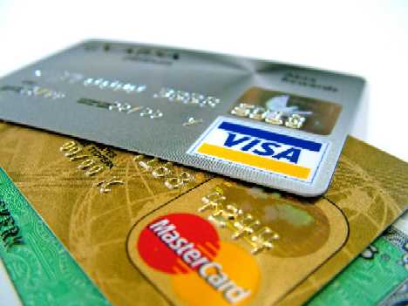
Credit Cards
Use only if necessary
Always pay off – avoid extra interest payments
Regent does not take Visa for online payments
Look for special cards for students or ones that give benefits you want (frequent flyer miles, cash back, etc.) – careful of hidden fees

Slide 7
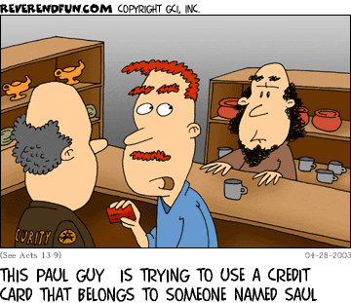
Identity Theft
Safeguard your Social Security Number, birthday, name
Many banks offer debit/credit cards with your photo on it
http://www.annualcreditreport.com
http://www.ftc.gov/bcp/edu/microsites/idtheft/

Slide 8
Ways to Save

Slide 9

Sales
Always happening
Right after a holiday is a good way to save on seasonal items
Certain holidays/seasons have traditional sales
January = White Goods (towels, linens)
Memorial Day = Guitar Center for musical instruments (VaBeach Blvd)
Sunday Newspaper has inserts
Grocery Stores – look at front of store for a flyer (Wednesday newspaper has a food section)
Register online and you can receive grocery stores weekly fliers
Drug Stores – look at front of store for a flyer

Slide 10
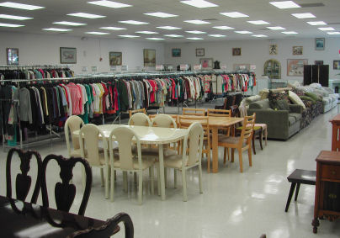
Thrift Stores
Items are used
Also known as:
Second-Hand Store, Charity Shop, etc.
Perfect for:
Baby Clothes
Used Furniture
Lightly used clothes
Other Household Goods

Slide 11

Thrift Stores
Local stores:
CHKD Thrift Store (Corner of Centerville/Kempsville)
Virginia Beach Blvd near corner of Newtown Road
Salvation Army
D.A.V.
Goodwill
CHKD Thrift Store on Indian River (near the corner of Indian River and Military Hwy.)
Union Mission Thrift Store at 4016 Indian River Rd. (go west on Indian River)

Slide 12
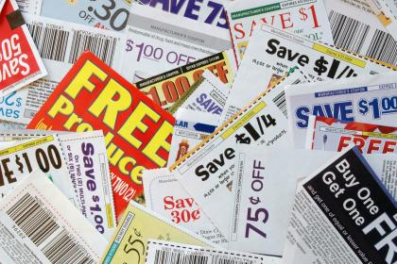
Food Coupons
Easy way to save money
Many stores offer double/triple coupons
Coupon for 50 cents = $1.00
Harris Teeter, Kroger, etc.
Often only on higher priced name brand products, compare price with generic, read the fine print
Store Cards; offer special discounts to those who have a card (go by names like MVP Card, Super Saver Card, etc.)

Slide 13
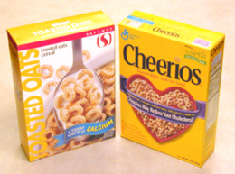
Generic Brands
Most major groceries offer a generic alternative to most food products
Each store has different “house” brand name
Wal-mart = Equate (toiletries, GW for food)
Harris Teeter Brand
Medicines, Prescription Drugs

Slide 14
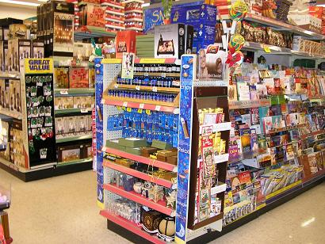
Store End Caps
Location where stores put:
Liquidation items
Sale items
Slightly damaged goods

Slide 15
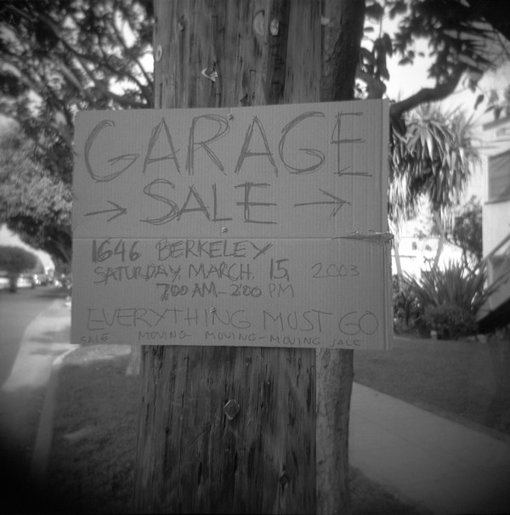
Garage / Yard Sales
Very popular on weekends
People moving, cleaning out their homes, etc.
Newspaper lists location in classified section
Don’t be afraid to negotiate
http://classified.hamptonroads.com/searchresults.cfm?category=4e

Slide 16
Online Shopping
Amazon.com
Overstock.com
Shipping Costs!
Make sure you can’t get it cheaper by going to the store.

Slide 17
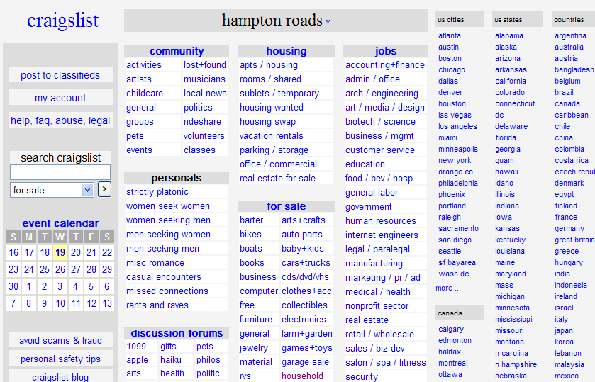
Craigslist
Free online classified ads
http://norfolk.craigslist.org/
Anything and everything
There is a list for almost every major city in the world

Slide 18
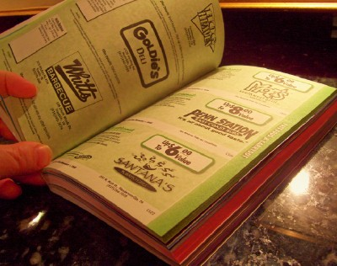
Other Coupons
Weekly flyers in the mail for goods and services from local companies
Entertainment Book
$20 – all sorts of specials, discounts
Restaurants, events, culture, sports, etc.

Slide 19
Student Discounts
Movies, Theme Parks, software, computers
Travel
Some retail stores: J. Crew, Apple
Regent Human Resources Office has a list of possible discounts:
http://www.regent.edu/admin/hr/discounts.cfm
Might change – best to check first. Some are only for staff – but some are also for students

Slide 20
Local Events
Lots of free events in the area; summer festivals, concerts, etc.
Hamptonroads.com
YMCA offers financial assistance, will need to provide proof of income (or lack thereof)
Matinee Movies (early in the day)
Museums offer student discounts, Chrysler Art Museum free on Wednesdays

Slide 21
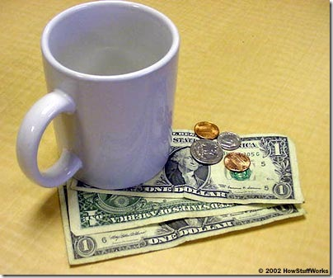
Dining Out
Buy one, get one free coupons found in weekly mailings, online
Skip the soda – water.
Tipping:15-20% off the pre-tax amount
Not included in check unless with a large group
Learn to cook: spending $20/week dining out is over $1,000 a year

Slide 22
Other Ideas?
Anything you do to save money?

